Slide 1

BY- KARTIKEYA SINGH
ADARSH PANDEY
SHARIQ IRSHAD
ADITYA SINGH
DAY3 MERN STACK TRAINING

Slide 2
INTRODUCTION TO CSS
•CSS (Cascading Style Sheets) is used to style web pages.
•• Controls colors, fonts, spacing and layouts
•• Improves user experience
•• Supports responsive design
2

Slide 3
CSS FUNDAMENTALS
•Topics Covered:
•• Background and text colors
•• Font size and font family
•• Text alignment
•• Styling body, headings and paragraphs
3

Slide 4
SELECTORS & STYLING
•• Element Selectors
•• Group Selectors
•• Inline CSS
•• CSS Classes
•• Reusable styling techniques
4

Slide 5
BORDERS AND OPACITY
•Border Types:
•• Solid
•• Dotted
•• Double
•• Outset
•Opacity values help create transparency effects and modern UI designs.
5

Slide 6
CLASSWORK PROJECTS
•Projects Built:
•• Login Form
•• Instagram Profile Card
•• Social Media Post Card
•Features included hover effects, profile sections, forms and interactive layouts.

Slide 7
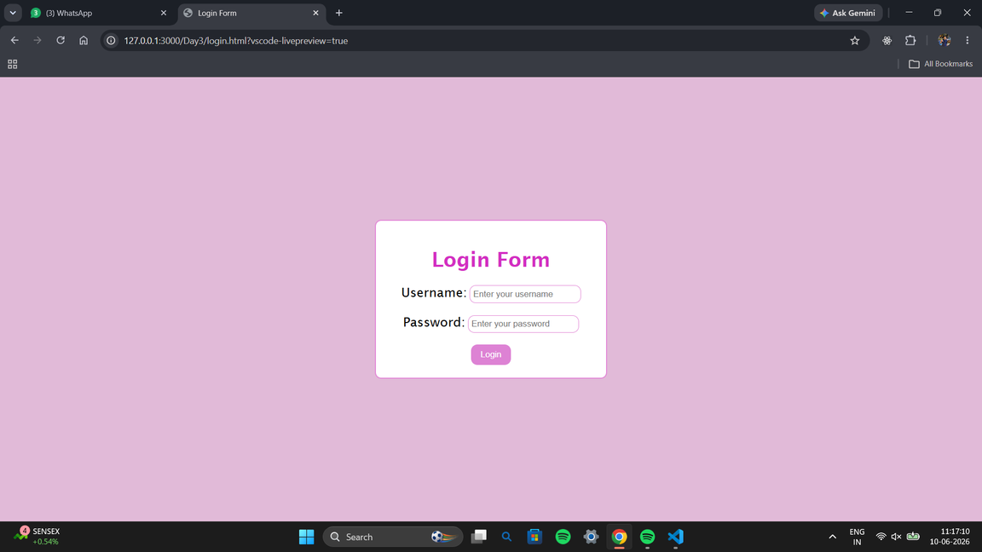
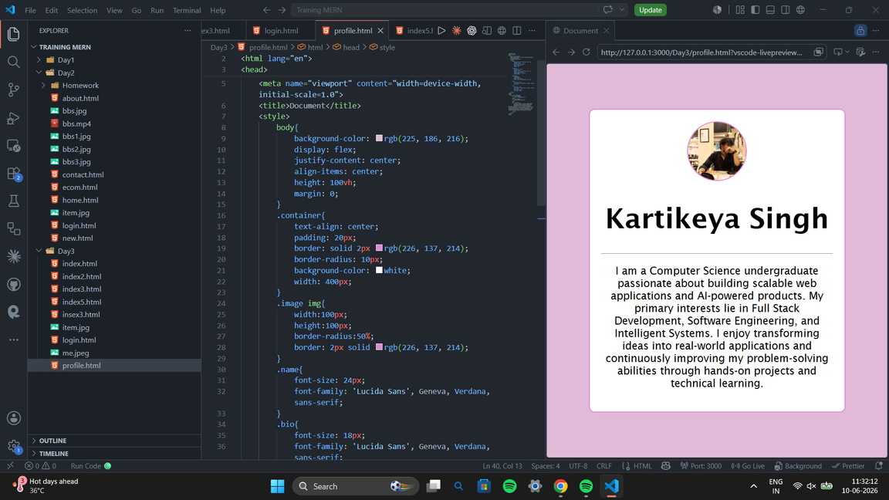
SCREENSHOTS

